Slide 1
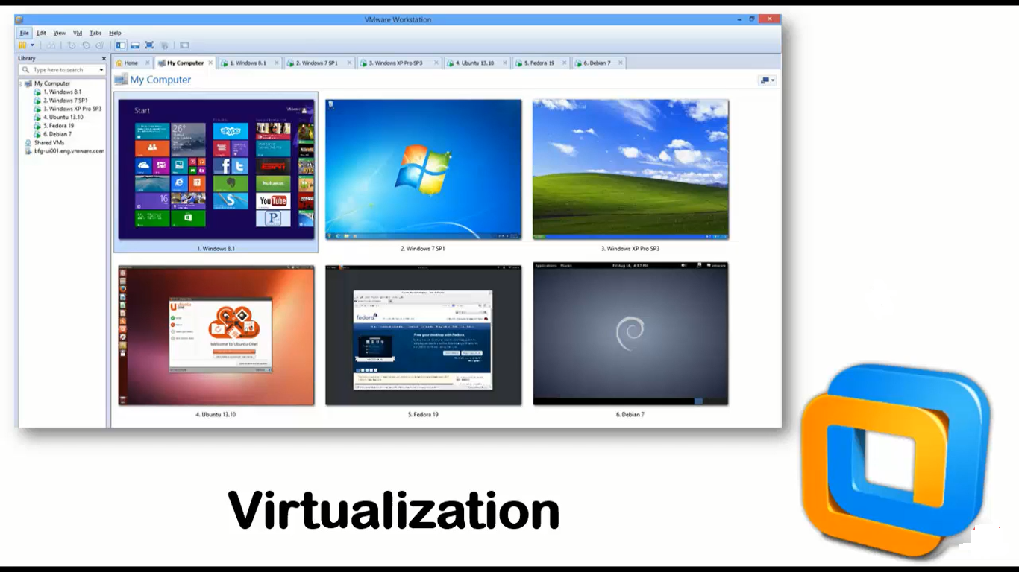
What is virtualization

Slide 2
Hyper-V
Hyper-V is Microsoft's hardware virtualization product. It lets you create and run a software version of a computer, called a virtual machine.
Each virtual machine acts like a complete computer, running an operating system and programs.
When you need computing resources, virtual machines give you more flexibility, help save time and money, and are a more efficient way to use hardware than just running one operating system on physical hardware.
Hyper-V runs each virtual machine in its own isolated space, which means you can run more than one virtual machine on the same hardware at the same time. You might want to do this to avoid problems such as a crash affecting the other workloads, or to give different people, groups or services access to different systems.

Slide 3
Some ways Hyper-V can help you
Establish or expand a private cloud environment. Provide more flexible, on-demand IT services by moving to or expanding your use of shared resources and adjust utilization as demand changes.
Use your hardware more effectively. Consolidate servers and workloads onto fewer, more powerful physical computers to use less power and physical space.
Improve business continuity. Minimize the impact of both scheduled and unscheduled downtime of your workloads.
Establish or expand a virtual desktop infrastructure (VDI). Use a centralized desktop strategy with VDI can help you increase business agility and data security, as well as simplify regulatory compliance and manage desktop operating systems and applications. Deploy Hyper-V and Remote Desktop Virtualization Host (RD Virtualization Host) on the same server to make personal virtual desktops or virtual desktop pools available to your users.
Make development and test more efficient. Reproduce different computing environments without having to buy or maintain all the hardware you'd need if you only used physical systems.

Slide 4
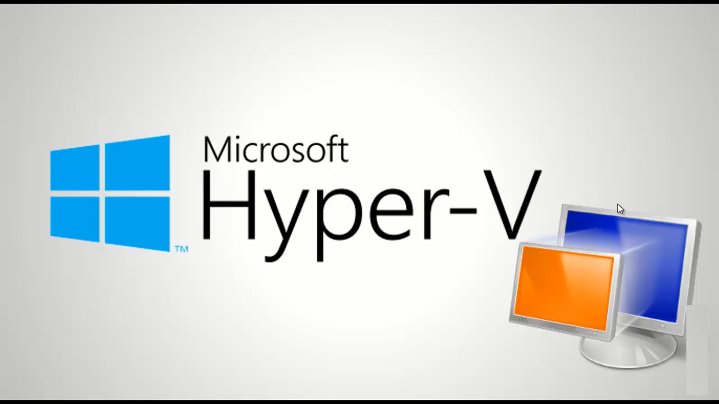
What is Hyper-V

Slide 5
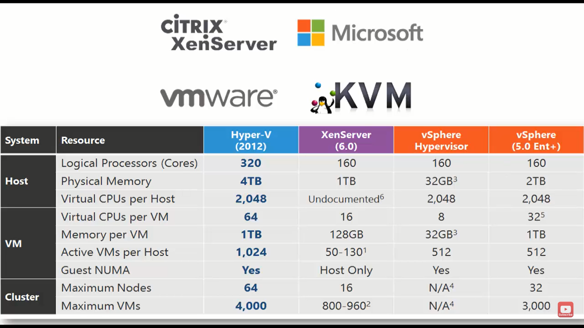
Why Hyper-V?

Slide 6
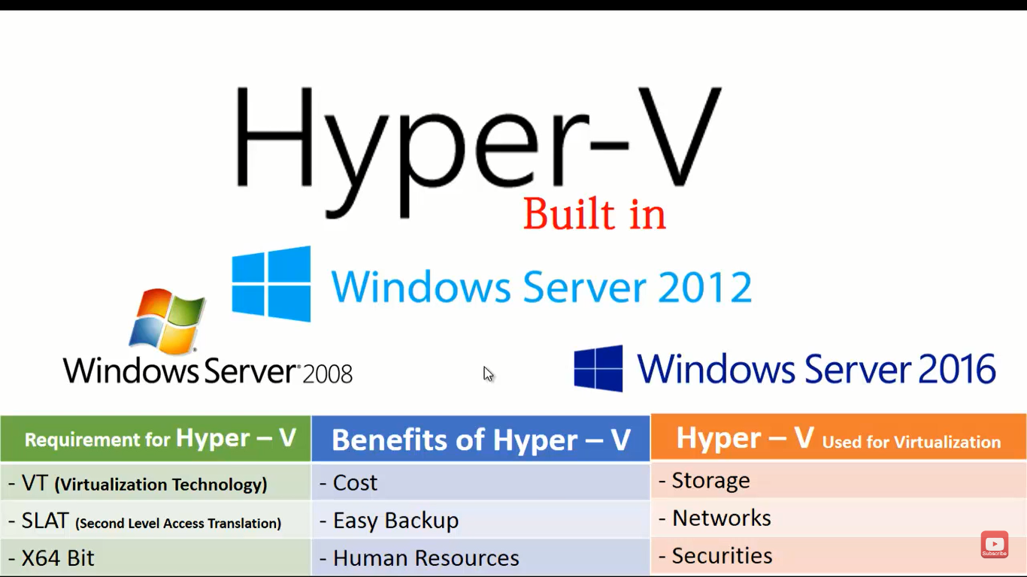
Hyper-V is available in Microsoft windows

Slide 7
How to install Hyper-V in Windows 10
Before starting the installation you must enable the virtualization feature in Windows BIOS.
1. Reboot your Computer and Press the BIOS Key. ...
2. Locate the section for CPU configuration. ...
3. Find the Settings for Virtualization. ...
4. Select the Option for Enabling Virtualization. ...
5. Save the Changes You Have Made. ...
6. Exit Your BIOS and Reboot Your Computer.

Slide 8
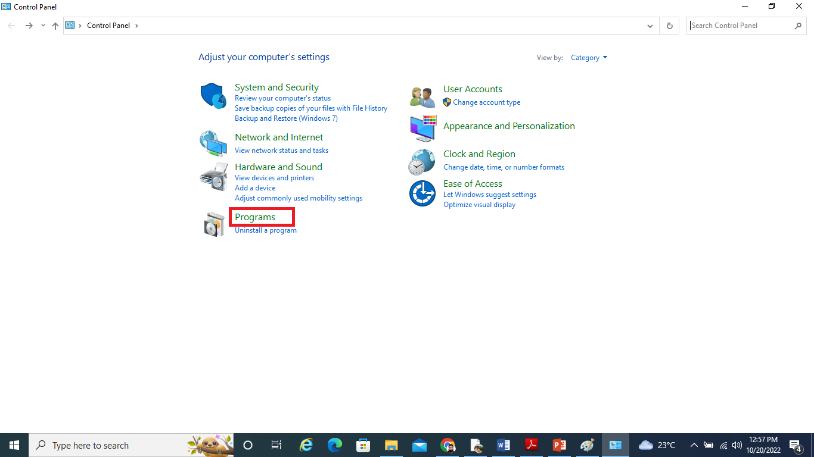
After restart the computer then Open control panel and then select programs

Slide 9
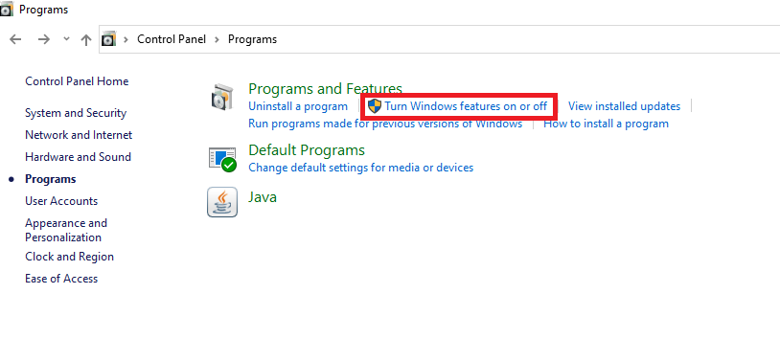
Click on turn windows features on or off

Slide 10
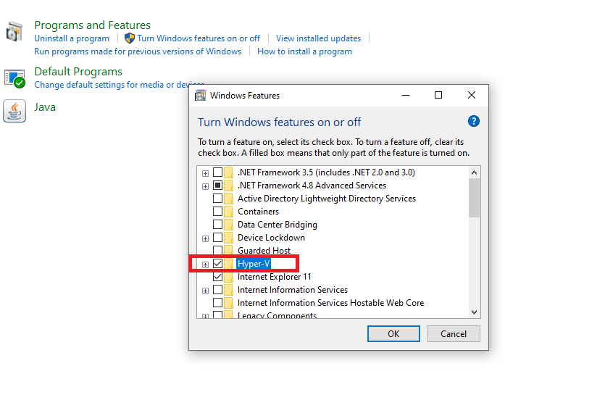
Check on Hyper-V option and click ok

Slide 11
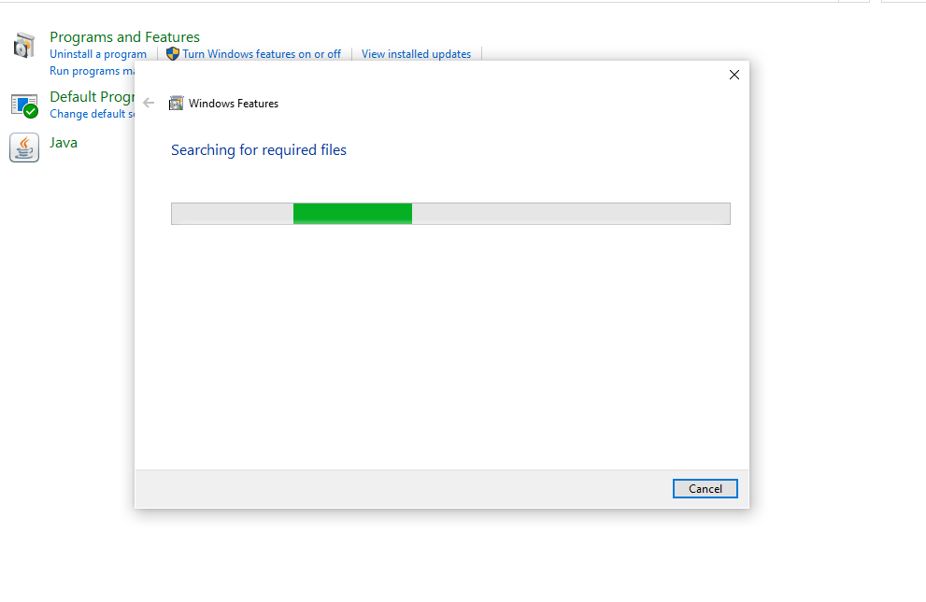
Please Wait for 2 to 3 minutes

Slide 12
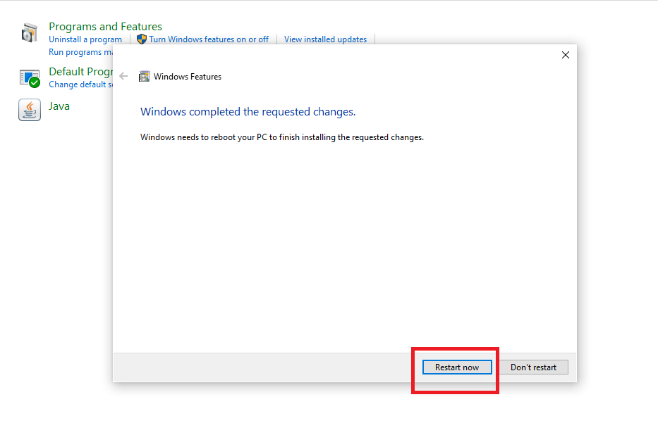
Click on Restart now

Slide 13
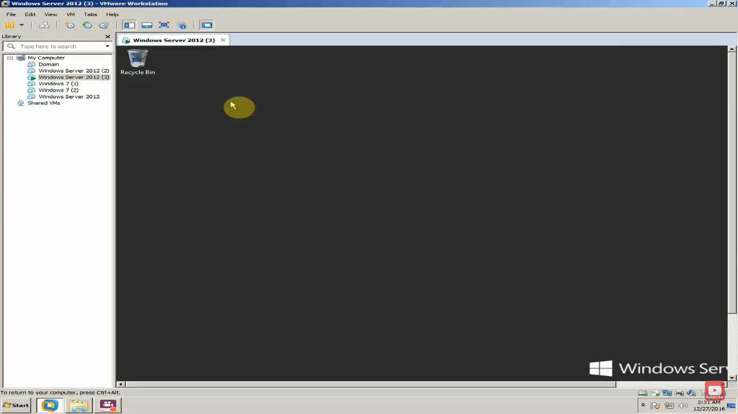
Hyper-V Installation in windows server 2012

Slide 14
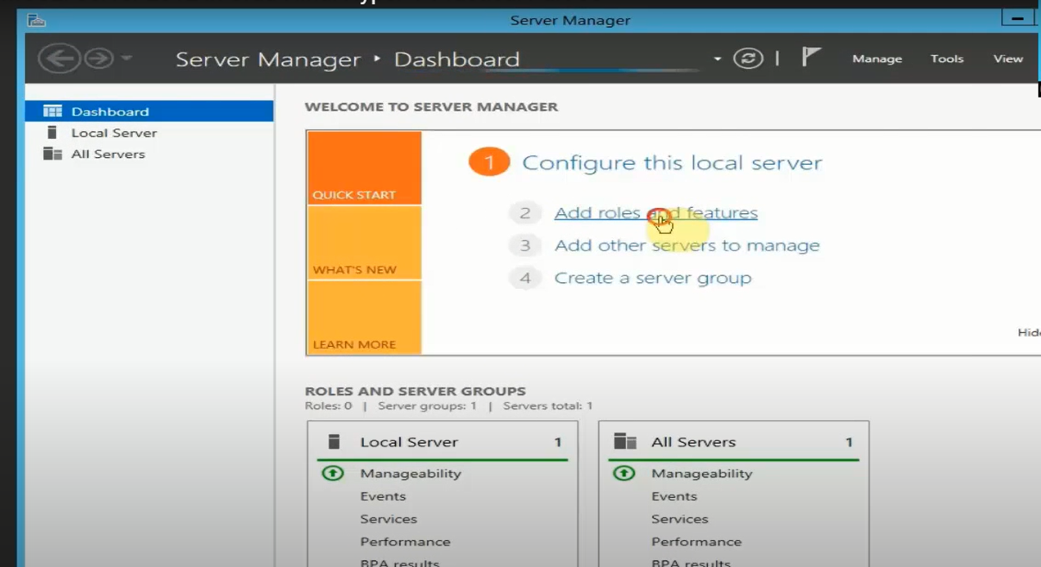

Slide 15
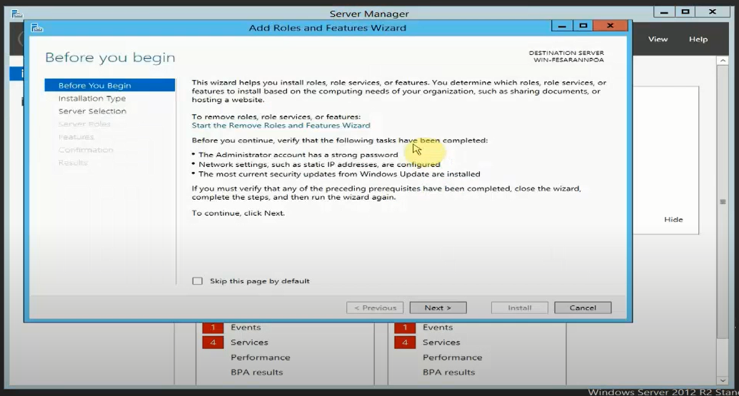

Slide 16
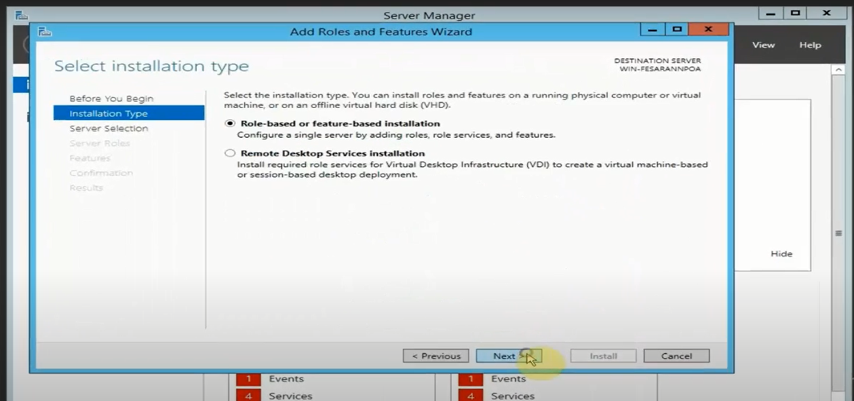

Slide 17
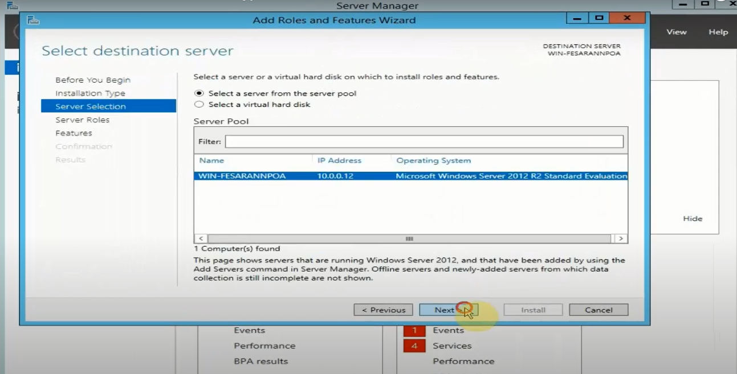

Slide 18
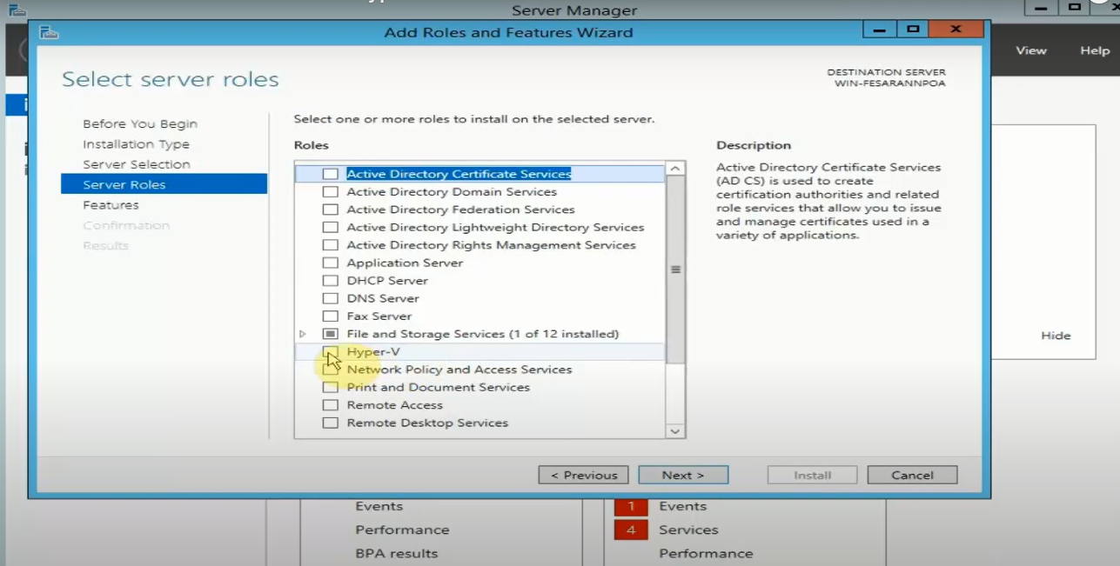

Slide 19
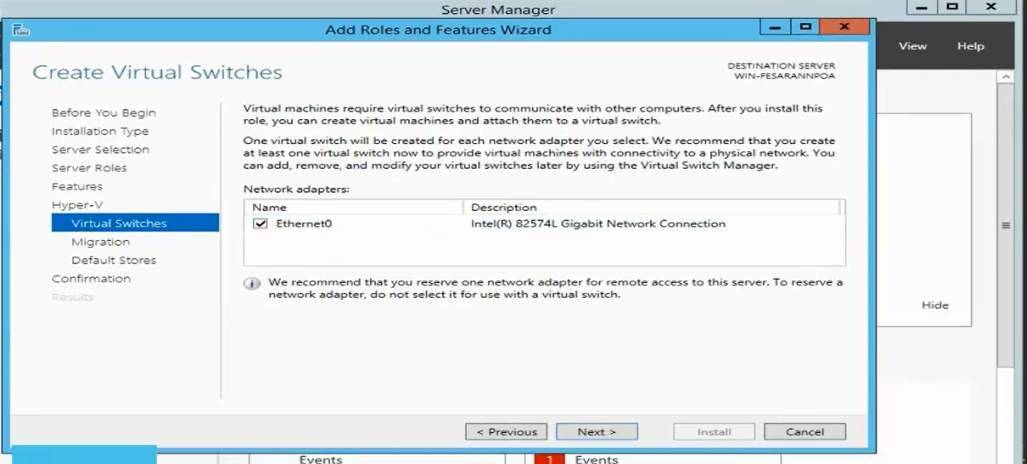

Slide 20
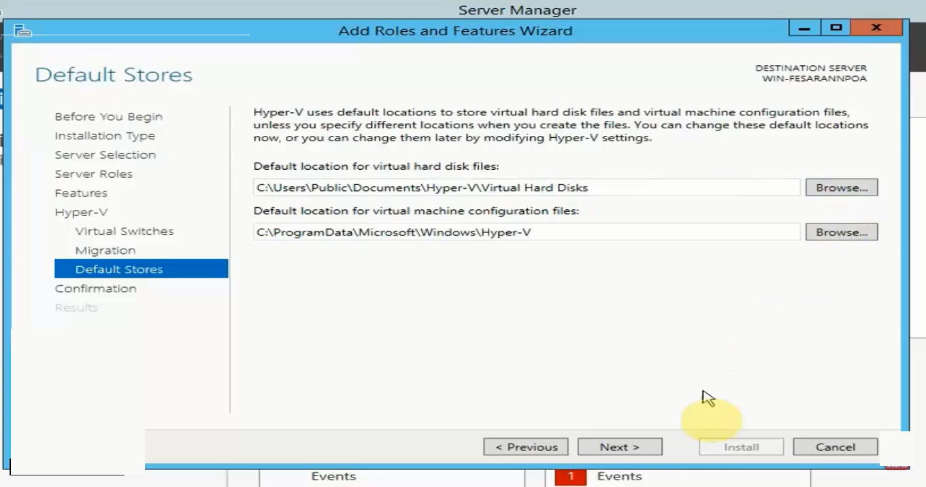
What is virtualization

Slide 21
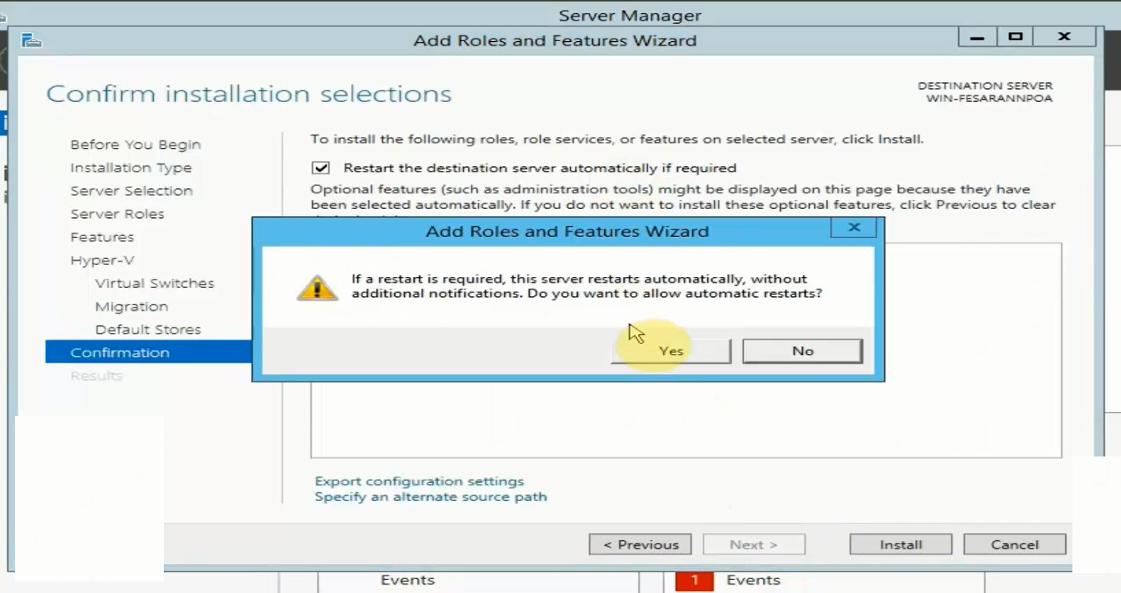
What is virtualization

Slide 22
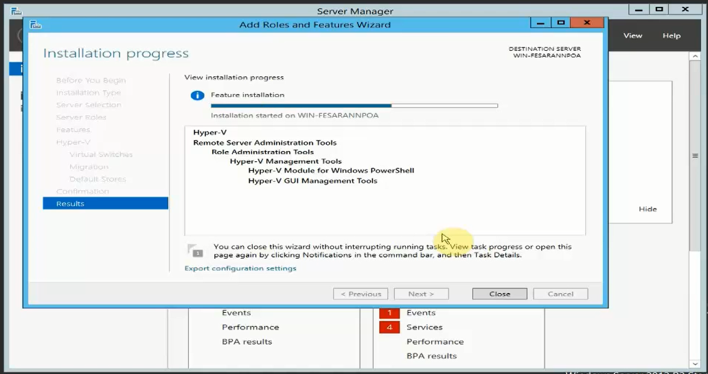
What is virtualization

